Slide 1
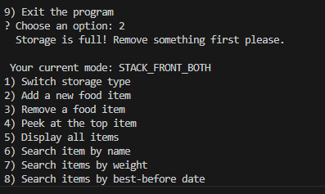
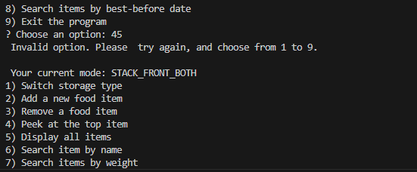

Fast-Food Storage Manager Using Stack and Queue (LIFO/FIFO)
Alberto W S Figueiredo
Student number 2023316
DATA STRUCTURE
The idea that servers like a pivot for the project is to replicate how a real-life restaurant would manage trays of food. And since is a fast-paced environment, the system must be organized and fast.
The chosen structure was “Deque” (double-ended Queue) supporting both LIFO and FIFO efficiently and allowing 0(1) time for insertion and to delete at both ends.
Which means it can behave both in STACK and QUEUE.
THREE MAIN CLASSES
Food Item
Storage
Main
Each operation is executed in constant time O(1), while Searches or displays in O(n).
TESTING AND VALIDATION
Before adding a tray the system will check if the storage is not full, the best-before date is not 14 days ahead and the format input is correct and weight is valid.
During the tests both modes worked seamlessly, showing the console output for each step. For an example adding around 3 trays and removing one shows that the correct tray was removed, accordingly to the mode you are using.
Here is a sample of a test, showing a full tray notification.
Here is a sample test of choosing and invalid option.
CONCLUSION AND REFLECTION
The Project focus was mainly to demonstrate how a deque can work for both Stack and Queue, making it possible to be flexible and efficient at the same time. Highlighting the main algorithm concept which are LIFO/FIFO and time complexity in the real world.
Building this application made sure that my understanding of data structure was enough to perform in such challenge and also emphasized the importance of testing and logical consistency.
PROBLEM DESCRIPTION
The main challenge was for the restaurant to manage trays with a maximum capacity of 8, while adding and removing from front or opposite .With two behaviors available
LIFO (stack) and FIFO (Queue)
LIFO (Last In, First Out): the most recently added tray is served first (like a stack of plates).
TIME COMPLEXITY ANALYSIS
FIFO (First In, First Out): the oldest tray is served first (like a production line).
Operation | Description | Time Complexity
Add (push) | Add item to stack | O(1)
Remove (pop) | Remove top item | O(1)
Peek | View top item | O(1)
Search | Loop through storage | O(n)
Display All | Show every item | O(n)
ADVANTAGES
Advantages were considered and efficient memory use was one of the main aspects that got me to choose the method, also the fact that two data-handling were being supported.
Preventing invalid data mainly trough validation checks and the fact that follows a clear OOP structure with a modular code.
LIMITATIONS
There were only a few limitations to be considered in the project, them being the fact that works only on the console, not allowing GUI.
The maximum number od trays being set to 8 only, and the fact that you cannot access items in the middle of the structure.
AI USAGE
Assistance from ChatGPT was used to refine ideas, improve commenting style, and prepare the project explanation. The coding and design decisions were made independently.

